Slide 1
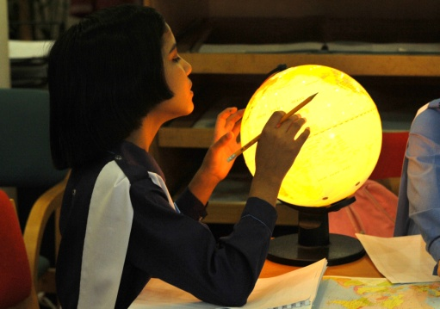
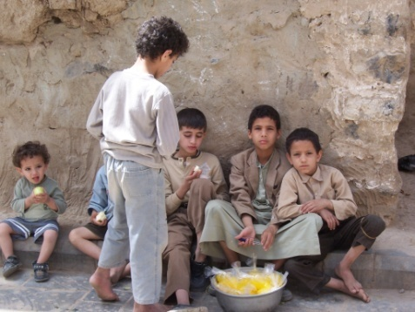
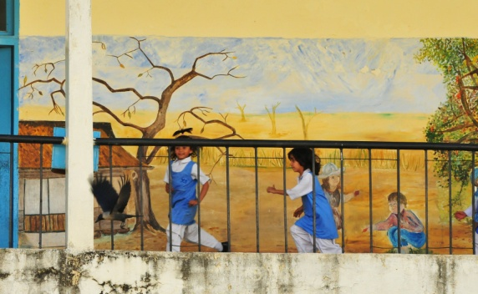
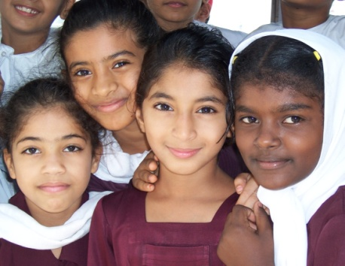
Understanding Education’s Role in Fragile and Conflict-Affected Situations
ICED: Education for a better future – Education for Peace Conference
London, April 02, 2011

Slide 2
Introduction to the Inter-agency
Network for Education in Emergencies (INEE)
About INEE:
Conceived in 2000
More than 5,000 members worldwide
Basic principles: education as human right; education in all humanitarian responses
Mission:
Serve as an open global network of members working together within a humanitarian and development framework to ensure all persons the right to quality education and a safe learning environment in emergencies and post-crisis recovery

Slide 3
INEE Working Group on
Education and Fragility
Objectives:
Strengthen consensus on what works to mitigate fragility through education while ensuring equitable access for all.
Support the development of effective quality education programmes in fragile contexts.
Promote the development of alternative mechanisms to support education in fragile contexts in the transition from humanitarian to development assistance.

Slide 4
Education in fragile and conflict- affected situations…
…is more than service-delivery
…is a means of socialization and identity development
…has multiple faces – can be part of the problem as well as part of the solution
To develop conflict-sensitive education systems, that contribute to peacebuilding:
Understand education’s role in fragile and conflict-affected situations

Slide 5
Research program: INEE Situational Analyses of Education and Fragility
Purpose of the research: to provide in-depth analyses of the relationship between education and fragility
Situational Analyses of Education and Fragility through 4 country case studies:
Afghanistan,
Bosnia-Herzegovina,
Cambodia, and
Liberia

Slide 6
Lenses for comparison…
1. The impact of education on particular domains of fragility
2. Education as negative or positive, across a spectrum of impact
3. Policy and programming challenges, dilemmas and lessons learnt

Slide 7
1. Domains of Fragility
How is the delivery of education services negatively impacted within fragile situations? What are the myriad of complex ways in which delivery of education may exacerbate or mitigate existing conditions of fragility?
Governance
Security
Social
EDUCATION
Economic
Environmental

Slide 8
2. The spectrum of impact of education on fragility . . .
Education actively or deliberately reinforcing and perpetuating fragility
Education reflecting the status quo
Education inadvertently favouring fragility
Education enabling people to live with fragility
Education making inroads into fragility
Negative -------------------------------------Positive

Slide 9
3. Policy and Programming: Challenges, Dilemmas and Lessons Learned
Access and quality
Lesson learnt: Ensure equal, generalized, and safe access to education while guaranteeing its quality and relevance.
Civic and social relevance
Lesson learnt: Promote national unity while acknowledging and respecting differences and particularities.
Economic relevance
Lesson learnt: Promote education for employment by matching skills and knowledge to the labour market and establishing education/employer partnerships.

Slide 10
3. Policy and Programming: Challenges, Dilemmas and Lessons Learned
Governance, management and finance
Private education provision
Lesson learnt: ensure quality private education while avoiding entrenching disparities and divisions; build creative public-private partnerships, bringing the private sector into national planning, and promote some form of regulation and accreditation for private schools.
Centralisation and decentralisation
Lesson learnt: promote adequate degrees of decentralisation in combination with some form of central regulation, while strengthening capacity and monitoring efficiency at both central and decentralised levels.
Funding modalities
Lesson learnt: ensure aid harmonization and aid alignment with government priorities, while also strengthening government management capacity with the aim of guaranteeing sustainability.

Slide 11
Policy challenges and dilemmas: quantity versus quality
Afghanistan | Bosnia Herzegovina | Cambodia | Liberia
Efforts to ensure generalised and safe access to education often requiring negotiation and compromise with Taliban, as well as alternative structures (e.g. radio education) Prioritisation of access and basic literacy coming at the expense of peace education programmes which are seen as a luxury in a context of low enrolments | Universalised access to education, but learning remaining ethnically divided, passive, uncritical, selective and politicised (e.g. history of the conflict); reform efforts, including textbook revision, being criticised for further politicising education | Expansion of education and school-building coming at the expense of quality: schooling characterised by passive and uncritical learning, limited economic relevance, and limited civic relevance (teaching history of genocide starting, but lack of topics related to contemporary key social issues, such as environmental education) | Efforts to get basic education up and running starving other sectors as well as diverting the focus from quality and relevance of education Free primary education policy leading to more and more over-crowded government schools, affecting quality Education for ex-combatants helping their re-integration, but adding to grievance of non-combatants
Notes:
11

Slide 12
Recommendations
Mapping the connections between education and fragility
Building and Strengthening a Functional Education System
Building and Strengthening People’s Capacity to Live and Cope with Fragility
Building and Strengthening Peace, the State and the Nation

Slide 13
Areas of research gaps
Include:
Improving the qualitative and quantitative data base
for education decisions
Assessing the impact of social science curriculum
Enhancing knowledge of the workings of community
governance
Surfacing the voice of the youth

Slide 14
INEE and the research community…
Emerging questions…
…how to build a strong evidence base around education and fragility
…who can do that
…how can we materialize the new WG’s objectives, is there a role to play for the research community?
Objective 1:
Facilitate a learning space for dialogue and information sharing on education’s role in state- and peace-building.
Objective 2:
Promote conflict-sensitive approaches to education in fragile contexts to influence decision-makers at all levels.

Slide 15
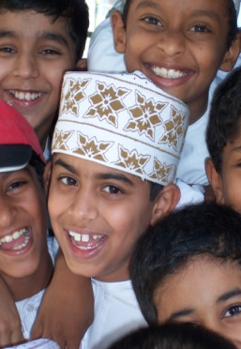
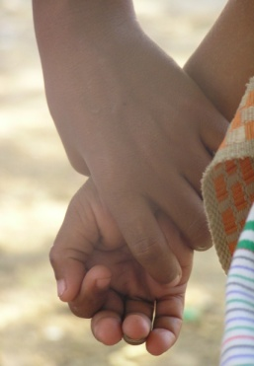
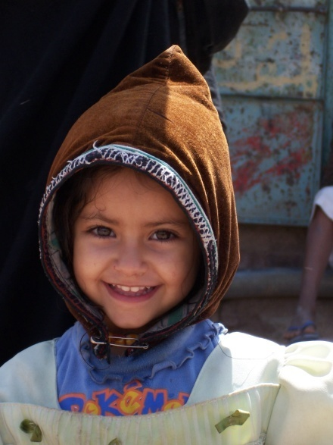
For more information about the
INEE Working Group on Education and Fragility,
visit
http://www.ineesite.org
Thank you!

Slide 16
In a nutshell: The multiple faces of education in conflict-affected and fragile contexts
Education can encourage inclusive and constructive integration of individuals and communities, which can contribute to…
conflict prevention and
long-term peacebuilding.
Conversely ...
depending on the nature of its design and implementation, education can perpetuate or entrench
dynamics of fragility.

