Slide 1
Civic Education for a Fragile Democracy: A Case Study of Project Citizen in the Philippines
By
Arnil Paras, LSE
Monica Ang, UA&P

Slide 2
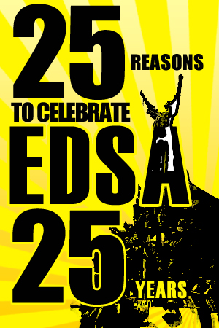
Philippines as a Fragile Democracy
Rise in Poverty
Lagging Good Governance
Human Rights Violations
Armed Insurgencies

Slide 3
Democratic Illiteracy

Slide 4
PCCED and Project Citizen
Project Citizen is a public high school-based training program for public policy research.
It involves a systematic training of student on how to identify local community problems, determine stakeholders, research on existing solutions, propose alternative solutions, and present their policy research to local government officials.

Slide 5
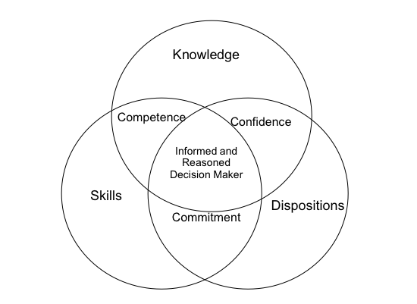
Project Citizen Pedagogy
Notes:
Source:
Presentation of Dr. Ferdinand Pingul for 3rd National Conference on Civic Education for Social Science Supervisors held in University of Asia and the Pacific, July 8-10, 2010.

Slide 6
Project Citizen Process
Notes:
Source:
Presentation of Dr. Ferdinand Pingul for 3rd National Conference on Civic Education for Social Science Supervisors held in University of Asia and the Pacific, July 8-10, 2010.

Slide 7
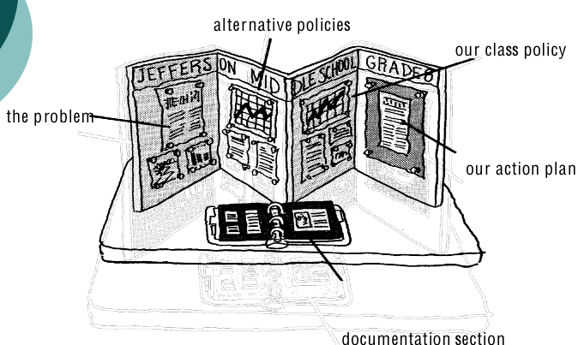
Project Citizen Portfolio
Notes:
Source:
Presentation of Dr. Ferdinand Pingul for 3rd National Conference on Civic Education for Social Science Supervisors held in University of Asia and the Pacific, July 8-10, 2010.

Slide 8
Project Citizen Evaluation
PC participants scored higher than non-PC participants in all measures: Civic Skills, Civic Knowledge and Civic Disposition
However, evaluation may suffer from sampling bias.

Slide 9
Project Citizen Evaluation
“I learned not to be selfish and to be a loyal youth to our community. As we were walking around our barangay to do some interviews, I noticed that there were a lot of problems that needed solving. I realize that there were bigger issues than what I was immersing myself with (fighting with my mom over household chores and getting home late).”

Slide 10
Project Citizen Evaluation
“For me, a good citizen should get involved in solving problems in the community. It is not that you do not care. Your eagerness to help should be there. You should be aware of what is happening in your barangay. A good citizen, even if not affected, should think of the people who will be affected and they should help as citizens. … if you won’t act, who will?”

Slide 11
Summary
Fragile Democracy and Project Citizen
Project Citizen Process
Project Citizen Evaluation

